Slide 1
Web-Based Product Display Application.
Fairness ■ Care ■ Collaboration ■ Integrity ■ Gratitude ■ Excellence

Slide 2



Introduction
Web-Based Product Display Application.
The Web-Based Product Display Application is designed for seamless product browsing and detailed sales analysis. Built to cater to both regular users and administrators, it blends ease of use with powerful data insights, offering a secure and engaging platform for users.

Slide 3

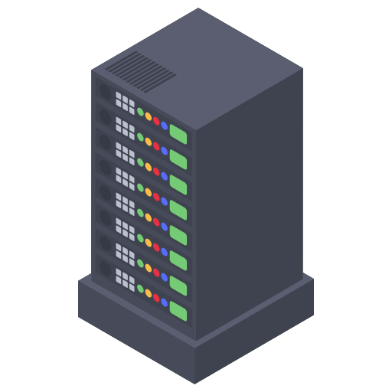

Project Overview
The Web-Based Product Display Application combines a React.js frontend, ASP.NET Core backend, and SQL Server database to deliver a complete shopping and sales analysis solution.
It offers dynamic product browsing, secure user authentication, and a robust data management system, ensuring a seamless experience for all users.
The application consists of three core layers: the frontend, backend, and database. Each layer plays a vital role in delivering a cohesive user experience.

Slide 4

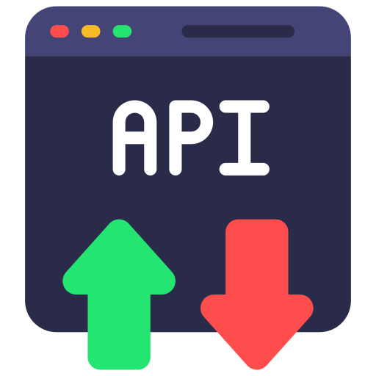

Technologies Used
Frontend Technologies
React.js: A powerful JavaScript library for building interactive UIs.
React Router: Facilitates smooth navigation between pages, including product listings and detailed views.
React Toastify: Provides user feedback with toast notifications for actions like adding items to the cart.
Axios: Used for making API calls, alloawing seamless communication between the frontend and backend.

Slide 5


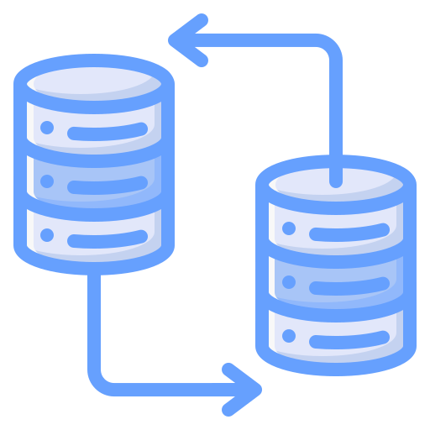

Technologies Used
Backend Technologies
Database
ASP.NET Core API: Handles business logic, data processing, and API routes, ensuring secure and efficient backend operations.
JWT Authentication: Provides secure user authentication and role-based access control.
Mailhog: A local SMTP server used for email testing during registration and password recovery.
SQL Server: Manages and user data ensuring data integrity while the product data comes from an external Api

Slide 6


Core Features & Target Audience
Regular Users:
Administrators/Managers:
Product Listing: A clean and visually appealing list of products with images and descriptions.
Filtering & Search: Easily find products using category filters or the search bar.
Cart Management: Add products to a cart with real-time updates to item count and total price.
Sales Data Visualization: Line charts and tables display sales trends over time.
Role-Based Access: Securely access and manage product data, ensuring that only authorized users can view sensitive information.
User Management: Update profile information and manage access levels for other users.

Slide 7




Thank you
www.singular.co.za
Johannesburg
25 Scott Street, Waverley, 2090
hello@singular.co.za
Cape Town
Brookside Office Park, 11 Imam Haron Road, Claremont, 7708
+27(0) 10 003 0700
London
58 Wood Lane, White City, W12 7RZ

